Slide 1
Fundamentals of Business Data Communications 14th Edition Alan Dennis & Alexandra Durcikova John Wiley & Sons, Inc
Dwayne Whitten, D.B.A
Mays Business School
Texas A&M University

Slide 2
Three Parts to Understanding Networking
Concepts of networking
How data moves from one computer to another over a network
Theories of how networks operate
Technologies in use today
How theories are implemented, specific products
How do they work, their use, applications
Management of networking technologies
Security
Network Design
Managing the network

Slide 3
Chapter 1
Introduction to Data Communications

Slide 4
Chapter 1 Outline
1.1 – Introduction
Brief history of Data Communications, Communications, Information Systems and the Internet
1.2 - Data Communications Networks
Network components, network types
1.3 - Network Models
OSI model, Internet model, transmission via “layers”
1.4 - Network Standards
Standards making, common standards
1.5 - Future Trends
Pervasive networking, integration of voice, video, and data, new information services
1.6 – Implications for Management

Slide 5
Information Age
1.1 Introduction
First Industrial Revolution
Introduction of machinery
New organizational methods
Changed the way people worked
Second Industrial Revolution – Information Age
Introduction of computers
Introduction of networking and data communication
Changed the way people worked again
Faster communication → Collapsing Information lag
Brought people together → Globalization

Slide 6
The Collapsing Information Lag
Historical developments in electronic communications
sped up the rate and volume of transmission of information
telegraph
1850
1900
1950
2009
Information took days or weeks to be transmitted
Information transmitted in minutes or hours
large quantities of information transmitted in a fraction of a second
growth of telecommunications and especially computer networks
Globalization
of networks
Digitalization

Slide 7
Advances in Phone Technology
first trans-continental and transatlantic phone connections
Telstar (Telecommunications via satellite), Fax services, digital transmission (T-carriers)
Packet-switched data communications
Phone invented
1876
1915
1948
1962
1976
1919
1969
1984
Strowger (stepper) switch,
rotary dial phones
(enabling automatic connections)
Microwave trunk lines (Canada)
Picturefone
(failed commercially)
Cellular telephone

Slide 8
Regulation of Inventions
FCC established
Regulation began in the USA (ICC)
Carterfone court decision allowing non-Bell CPE
A time for technological change
Deregulation
period
1876
1885
1900
1910
1934
1968
1996
AT&T
1970
1984
Phone invented (rapid acceptance)
Bell System:
de facto monopoly
Consent decree by US federal court
millions of phones in use in the US
MCI wins court case; begins providing some long distance services
1996 US Telecom Act

Slide 9

1984 Consent Decree
Divestiture of 1/1/84: RBOC’s
AT&T broken up into one long distance company (AT&T) and 7 Regional Bell Operating Companies (RBOC’s)
Deregulation: IXC’s and LEC’s
Competitive long distance (IXC) market; MCI & Sprint enter long distance telephone market (among others)
Local Exchange Carrier (LEC) service markets remained under RBOC monopoly

Slide 10
Worldwide Competitive Markets
Internet market
Extremely competitive with more than 5000 Internet Service Providers (ISPs) in the US alone.
Heavy competition in this area may lead to a shake out in the near future.
World Trade Organization (WTO) agreement (1997)
commitments by 68 countries to open, deregulate or lessen regulation in their telecom markets
Multi-national telecom companies
US companies offering services in Europe, South America
European companies offering services in USA

Slide 11
History of Information Systems
Online real-time, transaction oriented systems (replaced batch processing. DBMSs become common)
PC LANs become common
Batch processing mainframes
1950
1960
1970
1980
1990
2000
PC revolution
Data communications over phone lines (became common and mainframes became multi-user systems)
Networking everywhere

Slide 12
Internet Milestones
NSFNet created as US Internet backbone
commercial access to the Internet begins
Originally called ARPANET, the Internet began as a military-academic network
1969
1983
1986
1990
1994
2007
ARPANET splits:
Milnet - for military
Internet - academic, education and research purposes only
Government funding of the backbone ends
Worldwide: Over 1 billion Internet users

Slide 13
Net Neutrality
Net neutrality means that for a given type of content (i.e. email,
web, video, etc), all content providers are treated the same.
Net neutrality prevents ISPs from giving priority to some content
providers, while slowing down others

Slide 14
Thai Telecom
Thaicom 1A Launched
1.2 M Internet Hosts
TOT Established
Thaicom 2
1 Million Internet users
15 ISPs
Thaicom 4
Thaicom 5
Thaicom 3
16.1 M Internet Users
1954
2005
2006
2008
Mid 1980
1993
1994
1997
1998
2000
2007
2009
1 phone/100 people (TH)
5.6 phone/100 people (BKK)
5.4 M Tel Lines
2.3 M Mobile
7 M Tel
51 M Mobile
13 Internet users
CIA World Factbook
Notes:
CPE - Customer premise equipments

Slide 15
1.2 Data Comm Networks
Telecommunications =
Transmission of voice, video, and/or data
Implies longer distances
- Broad term
Data Communications =
Movement of computer information by means of electrical or optical transmission systems
convergence
Broadband Communications

Slide 16
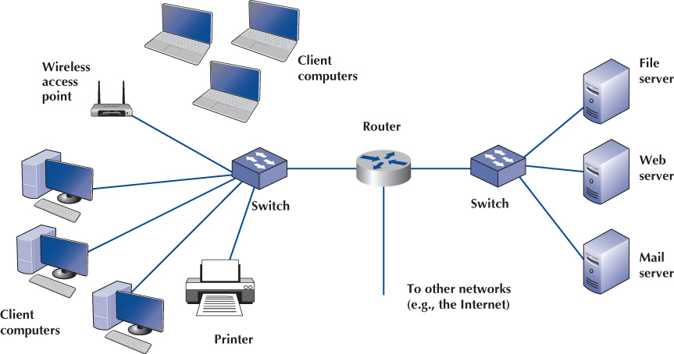
Components of a Local Area Network

Slide 17
Network Types (based on Scale)
Local Area Networks (LAN)
room, building
a group of PCs that share a circuit.
Backbone Networks (BN) - less than few kms
a high speed backbone linking together organizational LANs at various locations.
Wide Area Networks (WANs) - (more than a few kms)
connects LANs and BNs across different locations
Often uses leased lines or other services used to transmit data.

Slide 18
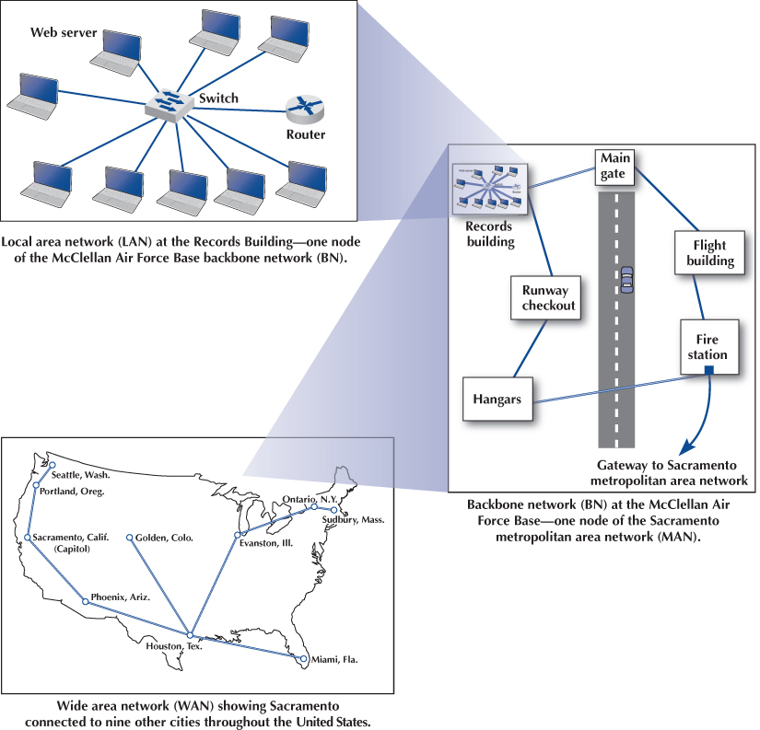
LANs and Backbones, Wide Area and Metropolitan Area Networks

Slide 19
Intranet vs. Extranet
Intranet
A LAN that uses the Internet technologies within an organization
Open only those inside the organization
Example: insurance related information provided to employees over an intranet
Extranet
A LAN that uses the Internet technologies across an organization including some external constituents
Open only those invited users outside the organization
Accessible through the Internet
Example: Suppliers and customers accessing inventory information in a company over an extranet

Slide 20
Layered Implementation of Communications Functions
Single layer implementation
-Networking with large components is complex to understand and implement
Applications
Applications
OS
Communication
Communication
OS
Applications
Applications
Multi layer implementation
Breaking down into smaller components
Easier to implement
OS
OS

Slide 21
1.3 Multi-layer Network Models
The two most important such network models: OSI and Internet
Open Systems Interconnection Model
Created by International Standards Organization (ISO) as a framework for computer network standards in 1984
Based on 7 layers
Internet Model
Created by DARPA originally in early 1970’s
Developed to solve to the problem of internetworking
Based on 5 layers
Based on Transmission Control Protocol/ Internet Protocol (TCP/IP) suite

Slide 22
7-Layer Model of OSI
Physical DataLink Network Transport Session Presentation Application
Application Layer
set of utilities used by application programs
Presentation Layer
formats data for presentation to the user
provides data interfaces, data compression and translation between different data formats
Session Layer
initiates, maintains and terminates each logical session between sender and receiver
“Please Do Not Touch Steve’s Pet Alligators”

Slide 23
7-Layer Model of OSI
Transport Layer
deals with end-to-end issues such as segmenting the message for network transport, and maintaining the logical connections between sender and receiver
Network Layer
responsible for making routing decisions
Data Link Layer
deals with message delineation, error control and network medium access control
Physical Layer
defines how individual bits are formatted to be transmitted through the network

Slide 24
Internet’s 5-Layer Model
Application Layer
used by application program
Transport Layer
responsible for establishing end-to-end connections, translates domain names into numeric addresses and segments messages
Network Layer - same as in OSI model
Data Link Layer - same as in OSI model
Physical Layer - same as in OSI model
Physical DataLink Network Transport Application
“Please Do Not Touch Alligators”

Slide 25
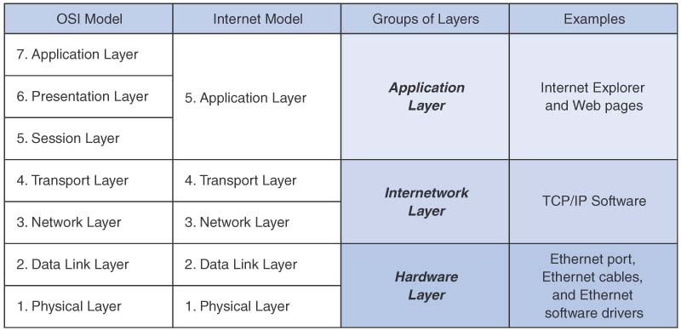
Comparison of Network Models

Slide 26
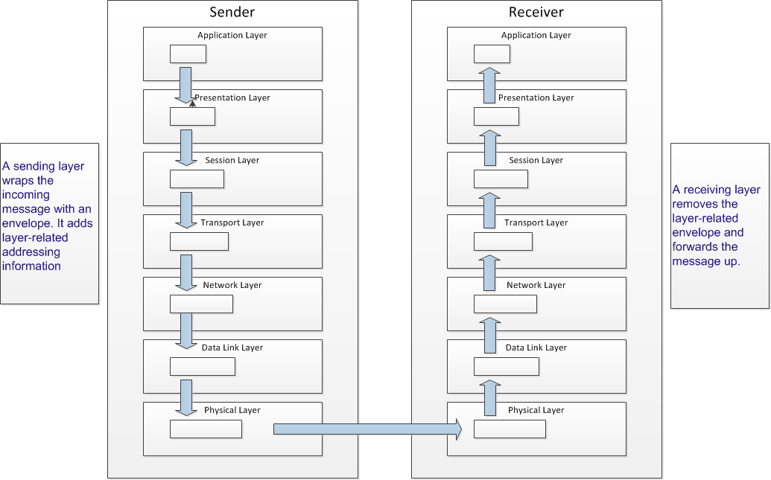
Message Transmission Using Layers

Slide 27
Protocols
Used by network model layers
Sets of standardized rules to define how to communicate at each layer and how to interface with adjacent layers
Layer N+1
Layer N+1
Layer N
Layer N
Layer N-1
Layer N-1
sender
receiver

Slide 28
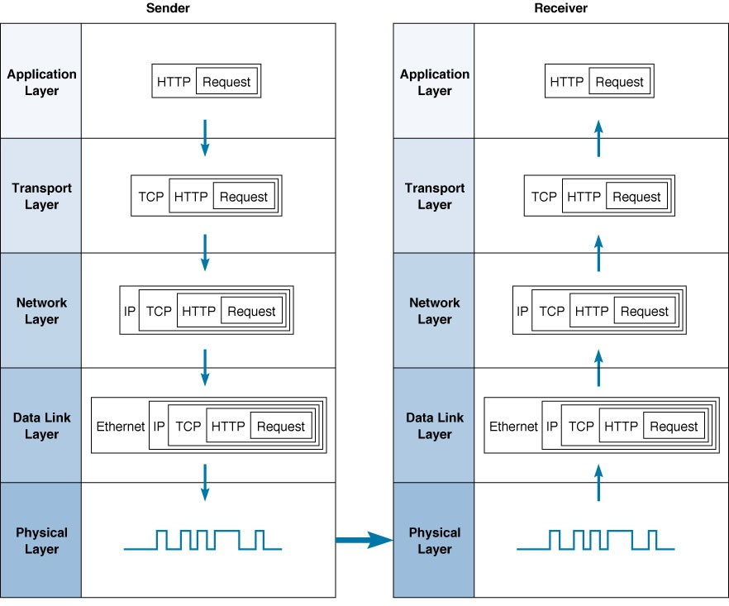
Message Transmission Example

Slide 29
Points about Network Layer View
Layers allow simplicity of networking in some ways
Easy to develop new software that fits each layer
Relatively simple to change the software at any level
Matching layers communicate between different computers and computer platforms
Accomplished by standards that we all agree on
e.g., Physical layer at the sending computer must match up with the same layer in the receiving computer
Somewhat inefficient
Involves many software packages and packets
Packet overhead (slower transmission, processing time)
Interoperability achieved at the expense of perfectly streamlined communication

Slide 30
1.4 Network Standards
Importance
Provide a “fixed” way for hardware and/or software systems (different companies) to communicate
Help promote competition and decrease the price
Types of Standards
The de jure (Formal) standards
Developed by an industry or government standards-making body
De-facto standards
Emerge in the marketplace and widely used
Lack official backing by a standards-making body

Slide 31
Standardization Processes
Specification
Developing the nomenclature and identifying the problems to be addressed
Identification of choices
Identifying solutions to the problems and choose the “optimum” solution
Acceptance
Defining the solution, getting it recognized by industry so that a uniform solution is accepted

Slide 32
Major Standards Bodies
ISO (International Organization for Standardization)
Technical recommendations for data communication interfaces
Composed of each country’s national standards orgs.
Based in Geneva, Switzerland (www.iso.ch)
ITU-T (International Telecommunications Union –Telecom Group
Technical recommendations about telephone, telegraph and data communications interfaces
Composed of representatives from each country in UN
Based in Geneva, Switzerland (www.itu.int)

Slide 33
Major Standards Bodies (Cont.)
ANSI (American National Standards Institute)
Coordinating organization for US (not a standards- making body)
www.ansi.org
IEEE (Institute of Electrical and Electronic Engineers)
Professional society; also develops mostly LAN standards
standards.ieee.org
IETF (Internet Engineering Task Force)
Develops Internet standards
No official membership (anyone welcome)
www.ietf.org

Slide 34
Some Data Comm. Standards
Layer
Common Standards
5. Application layer
HTTP, HTML (Web)
MPEG, H.323 (audio/video)
IMAP, POP (e-mail)
4. Transport layer
TCP (Internet)
SPX (Novell LANs)
3. Network layer
IP (Internet)
IPX (Novell LANs)
2. Data link layer
Ethernet (LAN)
Frame Relay (WAN)
T1 (MAN and WAN)
1. Physical layer
RS-232c cable (LAN)
Category 5 twisted pair (LAN)
V.92 (56 kbps modem)

Slide 35
1.5 Current Trends
Wireless LAN and BYOD
Internet of Things
Pervasive Networking
Integration of Voice, Video and Data
Massively Online
Cloud Services

Slide 36
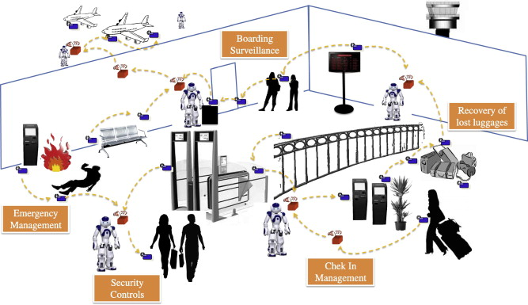
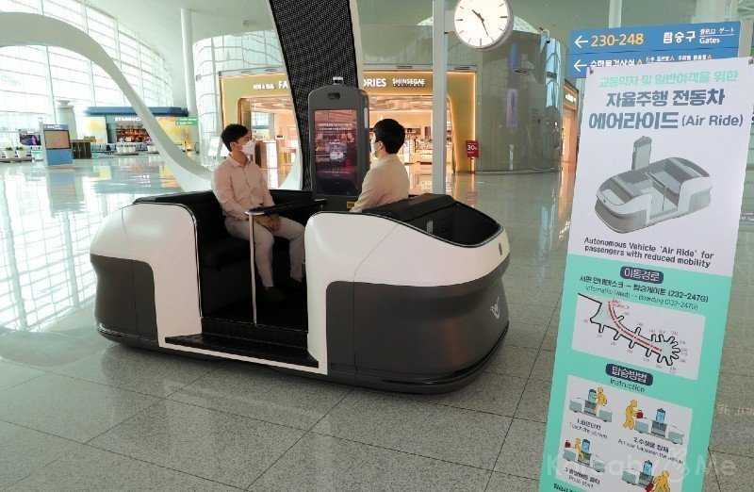
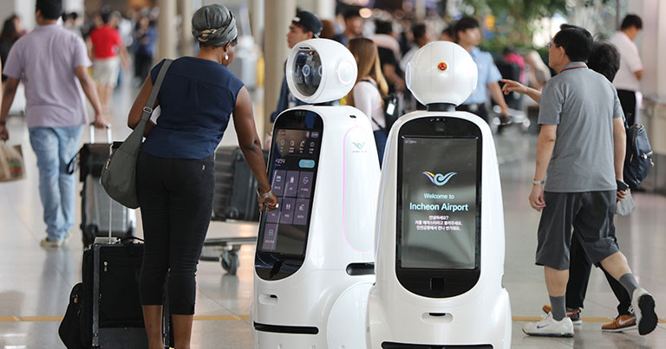
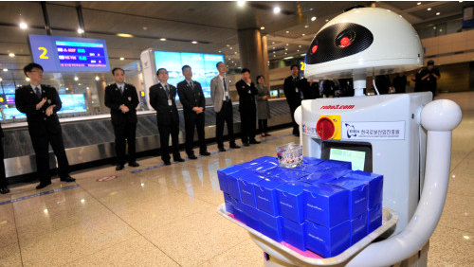

Slide 37
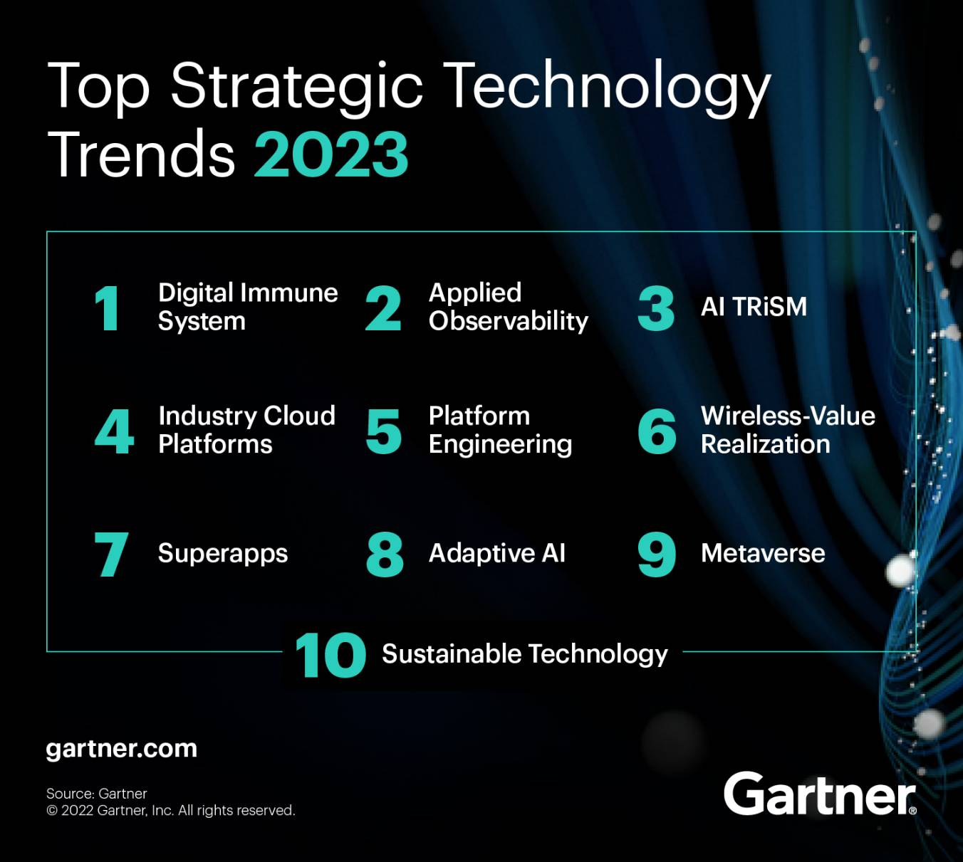
Optimize
Scale
Pioneer
Notes:
These trends optimize IT systems for greater reliability, improve data-driven decision making and maintain value and integrity of artificial intelligence (AI) systems in production.
Digital Immune System creates an enhanced customer experience by combining multiple software engineering strategies to protect against risk. Through observability, automation, and extreme design and testing, it delivers resilient systems that mitigate operational and security risks.
Applied Observability works from the data emitted by an organization, using AI to analyze and make recommendations, which allow an enterprise to make faster and more accurate future decisions. When applied systematically, it can reduce the latency for response and optimize business operations in real time.
AI TRiSM AI trust, risk and security management (AI TRiSM) supports AI model governance, trustworthiness, fairness, reliability, robustness, efficacy and data protection. It combines methods for explaining AI results, rapidly deploying new models, actively managing AI security, and controls for privacy and ethics issues.
Theme 2: Scale
These technology trends accelerate vertical offerings, increase the pace of product delivery and enable connectivity everywhere.
Industry Cloud Platforms combine SaaS, PaaS and IaaS with tailored, industry-specific functionality that organizations can use to more easily adapt to the relentless stream of disruptions in their industry.
Platform Engineering provides a curated set of tools, capabilities and processes that are packaged for easy consumption by developers and end users. It will increase end users’ productivity and reduce the burden on development teams.
Wireless-Value Realization covers the provision of wireless network services from everything, including traditional end-user computing, support for edge devices, digital tagging solutions, etc. Such networks go well beyond pure connectivity, providing location and other real-time information and insight from analytics, and allow systems to harvest network energy directly.
Theme 3: Pioneer
These trends focus on enabling business model change, reinventing engagement with employees and customers, and accelerating strategies to tap new virtual markets.
Superapps are more than composite applications that aggregate services. A superapp combines the features of an app, a platform and an ecosystem in one application, providing a platform for third parties to develop and publish their own miniapps on.
Adaptive AI allows for model behavior change post-deployment by using real-time feedback, to continuously retrain models and learn within runtime and development environments, based on new data and adjusted goals, to adapt quickly to changing real-world circumstances.
Metaverse allows people to replicate or enhance their physical activities. This could happen by transporting or extending physical activities to a virtual world or by transforming the physical one. It is a combinatorial innovation made up of multiple technology themes and capabilities.
Theme 4: Sustainable Technology
Delivering technology alone will not be enough in 2023. Sustainable technology is a framework of solutions that increases the energy and efficiency of IT services; enables enterprise sustainability through technologies like traceability, analytics, emissions management software and AI; and helps customers achieve their own sustainability objectives.
Investments in sustainable technology also have the potential to create greater operational resiliency and financial performance, while providing new avenues for growth.

Slide 38
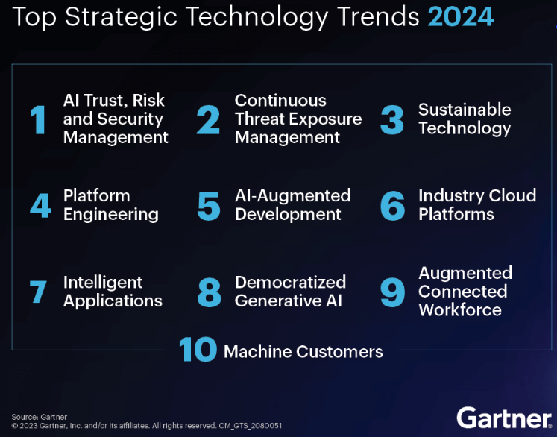

Slide 39
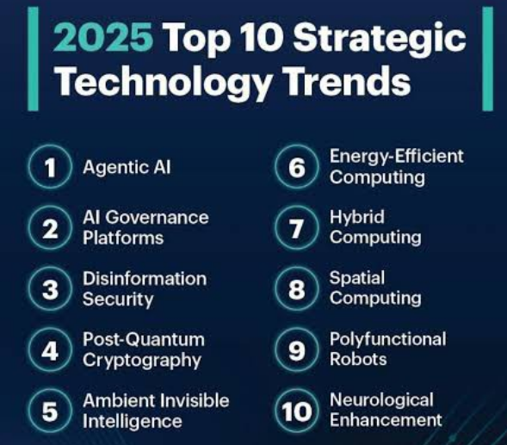

Slide 40
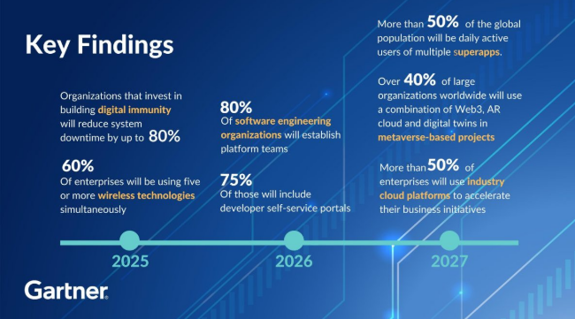
Notes:
A robust digital immune system protects applications and services from anomalies, such as the effects of software bugs or security issues by making applications more resilient so that they recover quickly from failures.
Here are some examples of wireless technologies:
5G: The latest generation of wireless technology, 5G can transmit data at speeds of up to 10 gigabits per second, which is 100 times faster than 4G. Millimeter waves are a promising technology for 5G wireless communications.
Wi-Fi: Wi-Fi can operate on 2.4GHz and 5GHz, with 5GHz being less congested. Wi-Fi has two modes: access point (AP) mode and station mode.
Cellular: Cellular networks provide reliable broadband communication for voice calls and streaming applications.
V2X: V2X technology allows vehicles to communicate with their surroundings, including other vehicles, pedestrians, and infrastructure. This technology is expected to be important for road safety and traffic management in smart cities and with autonomous vehicles.
Satellite: Satellite communication uses satellites orbiting the Earth to transmit and receive signals. It's commonly used for GPS navigation, weather forecasting, and television broadcasting.
Other wireless technologies include: Radio and television broadcasting, Radar communication, Bluetooth, and Radio frequency identification

Slide 41
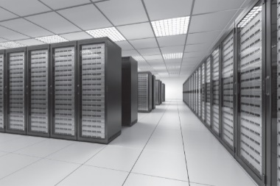
1.6 Implications for Cyber Security
Network and Internet change almost everything
Quickly and easily to move information inside and outside firm
Easy for cyber criminals to steal info and attack.
Understand network and Internet is the first step of defense.
Variety of devices connected as BYOD
Increase the risks as does the IoT
Secure the computing infrastructure
High demand on network services and capacity
Secure storage and server space and secure transfer of data
High Cost on power and staffing
Cloud can meet or exceed government requirement
Internet of Things
or
Internet of Targets
IoT

Slide 42
Ubiquitous
adj. “yoo-bik-wi-tuhs”
Being or seeming to be everywhere at the same time (American Heritage® Dictionary)
Existing or being everywhere at the same time : constantly encountered : widespread (Merriam-Webster Dictionary)

